Slide 1

Name: Salvia Rahman Student ID: 301114183 Course Code: COMP 229 Course Name: Web Application Development Assignment 1: Express Portfolio Site
1
2
3
3
3
Home Page
About
Projects
Services
Contact
4
4
4
5
5
5

Slide 2
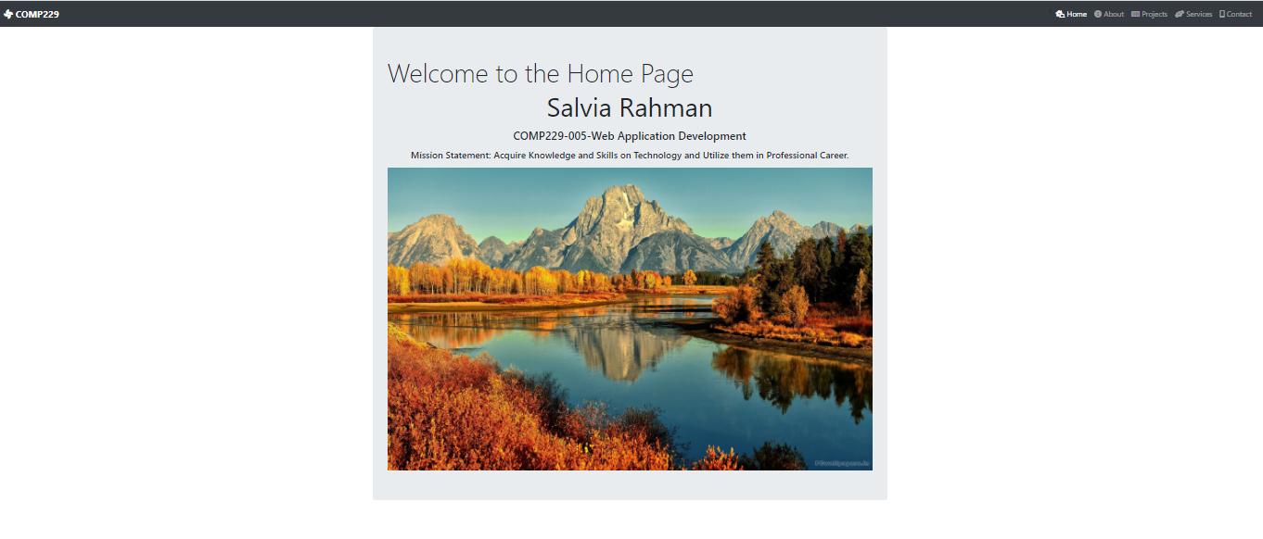
Home Page

Slide 3
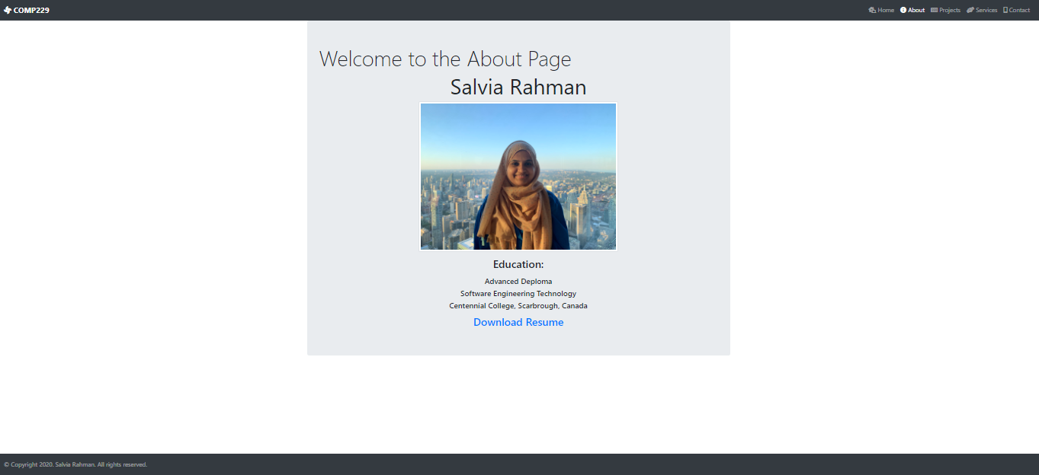
About

Slide 4
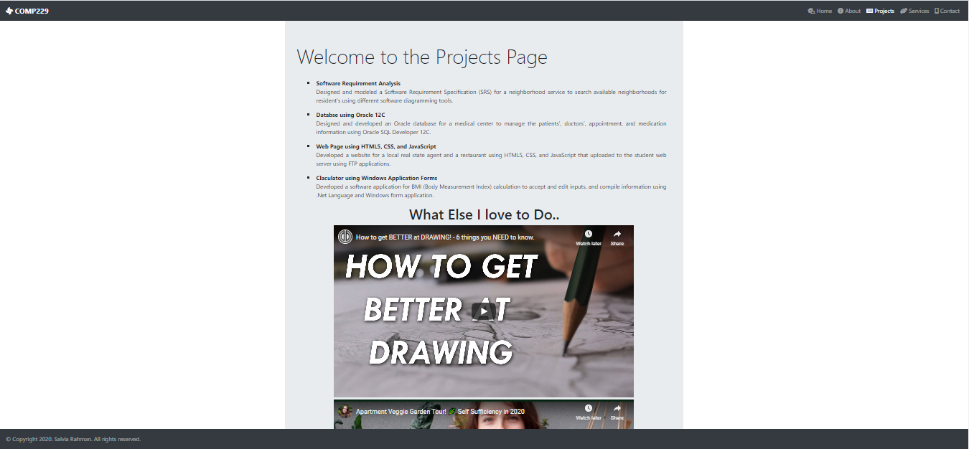
Projects

Slide 5
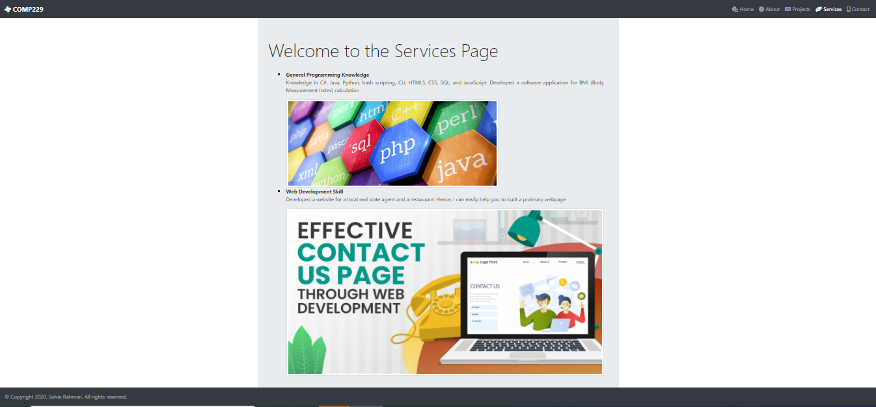
Services

Slide 6
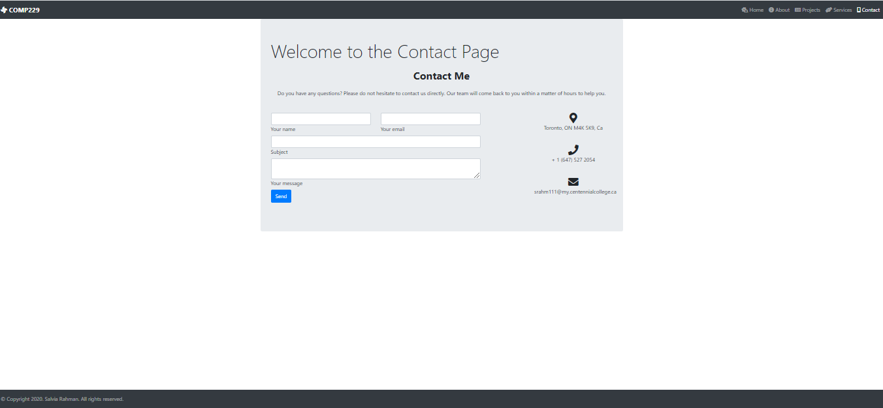
Contact

